Slide 1
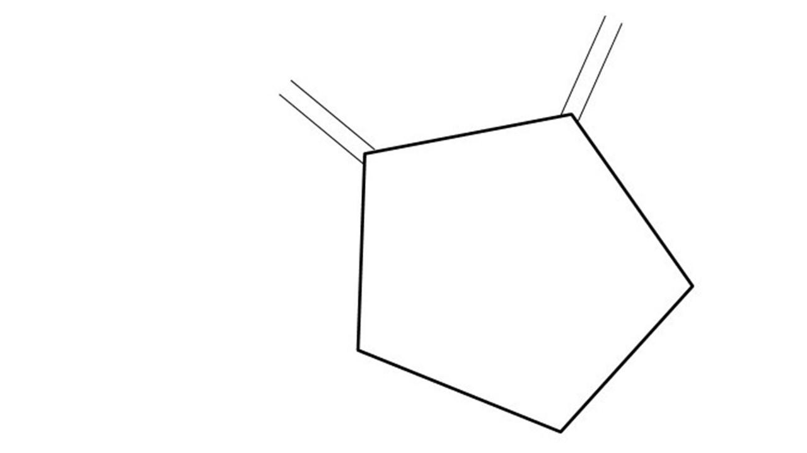


Great Cow BASIC Part 11
Great Cow BASIC for the PIC16F171xx chip Family
Oct 2022

Slide 2
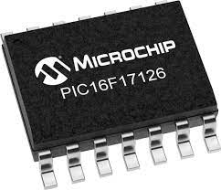
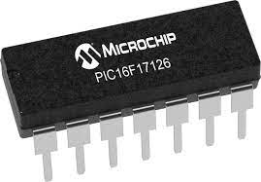
PIC16F171xx
PIC16F171xx is a high performance PIC16
Digital and Analog peripherals
12-bit ADC
Multiple communication interfaces
Serial, I2C, SPI
PWM – CCP/PWM and 16Bit
Configurable Logic Cells
OpAmp
The PIC16F171xx offers 8 to 20 pin products in small footprint packages to support customers in a variety of space constrained and sensor node applications.

Slide 3
Videos...
Install the hardware and make the board work – three LED programs
Make four LEDs flash in a sequence
Set the LEDs to represent the value of ADC
Sequence the LEDs with a delay using the value of ADC
Using an input to set the state of the LED
Using the reset switch
Using the switch, ADC – the LEDs flash in a sequence with reverse
Using the serial to display values
Using the timer0 overflow, 8bit timer, 16bit timer to flash the LEDs
Using CCP/PWM to dim the LEDS
Using I²C with serial to discover I2C devices
Using EEProm – showing values on the serial terminal
Using an I²C GCLD display
Using an SPI GCLD display
Using PWM to dim the LEDS
Using memory within the PIC – Progmem and SAF memory
The Great Cow BASIC tool chain
Assembly and alternatives assemblers
Summary

Slide 4
Great Cow BASIC Compiler
Great Cow BASIC is an Open Source compiler for Microchip PIC &AVR and Logic Green AVR microcontrollers
Great Cow BASIC now supports the 16F171xx chip family
Great Cow BASIC Compiler

Slide 5
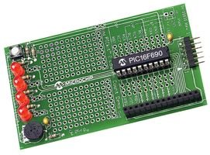
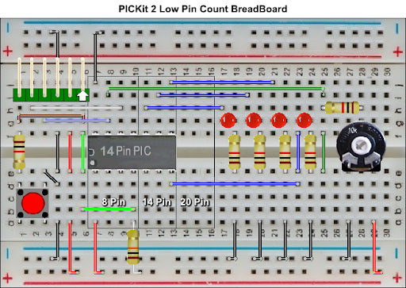

Hardware
Microchip Low Pin Count Demo Board
PICKit_2_Low_Pin_Count_User_Guide_51556a.pdf
By Chris Roper

Slide 6
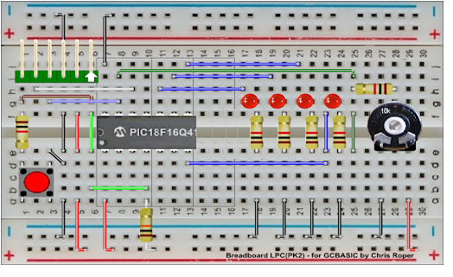
Hardware
Layout
16F17126
By Chris Roper

Slide 7
I²C uses…
I²C uses two bidirectional open collector or open drain lines pulled up with resistors
Serial Data Line (SDA)
Serial Clock Line (SCL)
Typical voltages used are +5 V or +3.3 V, although systems with other voltages are permitted

Slide 8
Hardware
Clock
4. I²C
1. GND
Layout
16F17126
2. VCC
3. I²C
Data
TX

Slide 9
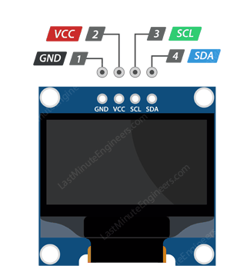
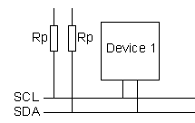
Setup
CLOCK (SCL)
PORTA.1/PPS
VCC
DATA(SDA)
PORTA.4/PPS

Slide 10
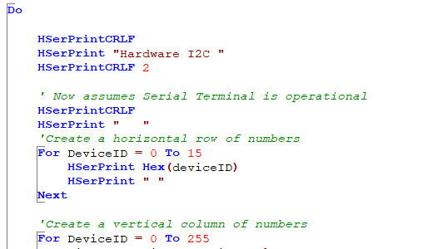
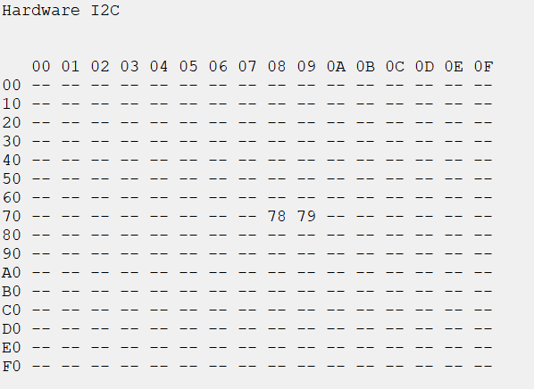
I2C Discovery

Slide 11
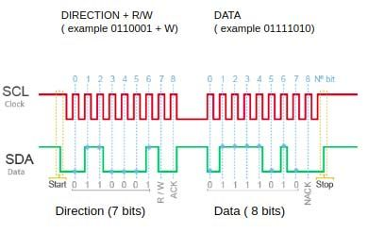
I2C Discovery
Process overview
For deviceID= 0 to 255
Send I2CStart
Send I2C (deviceID)
If an deviceID responds then Send I2C(0)
Send I2CStop
Troubleshooting
Reset layout, check your connections, check the voltage, check the pull ups to VDD, check signals and, then, analyse I2C protocol
If I2C discovery does not work.. Then, do not expect the I2C devices to work

Slide 12
Lab
Examine the sample code
Using PPS select the I²C ports
Using PPS select the serial USART port
Set up the I²C
Review the code
See the results

Slide 14
Videos...
Install the hardware and make the board work – three LED programs
Make four LEDs flash in a sequence
Set the LEDs to represent the value of ADC
Sequence the LEDs with a delay using the value of ADC
Using an input to set the state of the LEDs
Using the reset switch
Using the switch, ADC – the LEDs flash in a sequence with reverse
Using the serial to display values
Using the timer0 overflow, 8bit timer, 16bit timer to flash the LEDs
Using CCP/PWM to dim the LEDS
Using I2C with serial to discover I2C devices
Using EEProm – showing values on the serial terminal
Using an I2C GCLD display
Using an SPI GCLD display
Using PWM to dim the LEDS
Using memory within the PIC – Progmem and SAF memory
The Great Cow BASIC tool chain
Assembly and alternatives assemblers
Summary

Slide 15
Great Cow BASIC Part 11
Great Cow BASIC for the PIC16F171xx chip Family
Oct 2022

Slide 17
Backup Slides

Slide 18
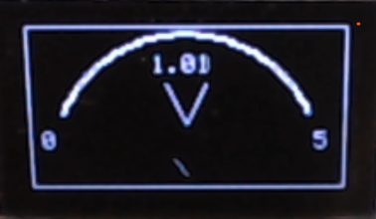
I²C

